Slide 1

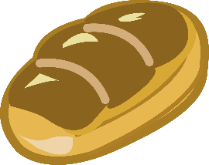
빵을 모으기 하려고 해요. 빈칸에 빵을 모두 끌어다 넣어 보세요.
#2
#3
4
2
#5
6
#4
Notes:
1) (narration plays) 빵을 모으기 하려고 해요. 빈칸에 빵을 모두 끌어다 넣어 보세요. [sound track name : M3-8-1-1-s001]
2) users drag #2 (breads) and #3 (breads) to #4 (magnet effect**), and when they put the bread on #4, #5 is automatically calculated. (auto_increment: 1,2,3,4,5,6)
** magnet effect means users don’t necessarily put it on the exact place. as long as the bread is near enough to the place (gray area) and the same bread area, it goes to the place exactly.
otherwise, the image goes back to the original place.
3) conclusion narration plays
빵 4개와, (-> #2 the whole images blinking twice according to the narration) [soundtrack: M3-8-1-1-s002]
2개를 모으기 하면, (-> #3 the whole images blinking twice according to the narration) [soundtrack: M3-8-1-1-s003]
빵 6개가 되므로, (-> #4 the whole images blinking twice according to the narration) [soundtrack: M3-8-1-1-s004]
4와 2를 모으기 하면 6이 됩니다. (-> text #5 is blinking twice) [soundtrack: M3-8-1-1-s005]

